Slide 1

2020 American Institute of Steel Construction
Student Steel Bridge Competition
CENE 486: Final Presentation
Samantha Cole
Emalee Sena
Hailey Ndubizu
Steven Bloomfield
April 2020
Notes:
Emalee

Slide 2
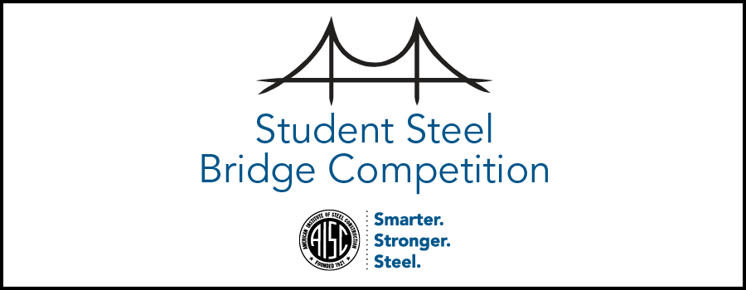
Project Information
American Institute of Steel Construction (AISC) Student Steel Bridge Competition
  Conference Location: Cal State Fullerton
March 31 - April 4, 2020
Client: Mark Lamer
Purpose: Design, Fabricate, Construct and Compete
Design of 1:10 scale bridge
Figure 1: AISC Logo [1]
Notes:
Em

Slide 3
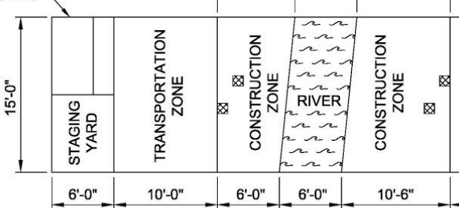
Competition Details
*Competition was canceled due to COVID-19, with no virtual component or opportunity to compete
The team completed construction
Next years team can use the same envelope, bridge, and rules
Figure 2: Construction Site plan Specifications provided by AISC Rules [1]
Notes:
Steven

Slide 4
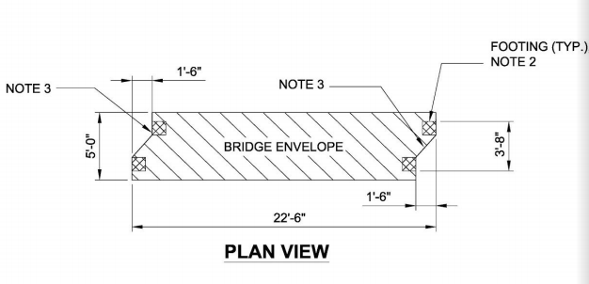
Technical Considerations for Full Bridge
Loading Test
50 pound lateral load
2500 pound vertical load
Rules Specification
Has a skew of 1’-6”
Must fit envelope of 22’-6”, 1’-8’’ and 3’-8’’
Figure 3: Envelope Specifications provided by Rules [1]
Notes:
Sam

Slide 5
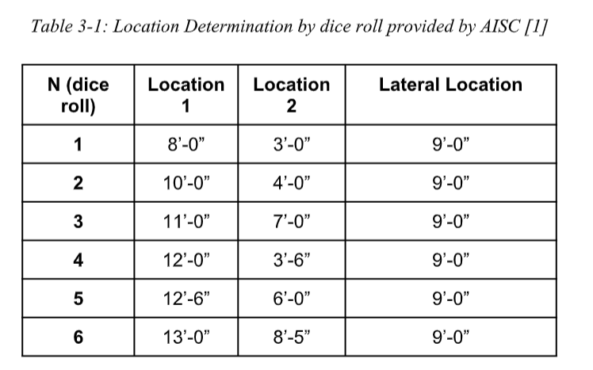
Load Combination
ASCE 6 potential vertical loading combinations
Bridge must be able to withstand all loads applied to each location
Table 1: Location Determination by Dice Roll [1]
Notes:
Emalee

Slide 6
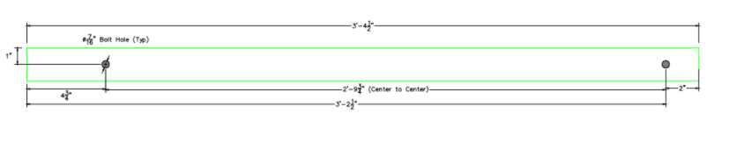
Technical Consideration
Rules Set by Competition for Members
Each member can not exceed an envelope 42’’x 6”x 4”
Every member must be connected by a nut and bolt
Figure 4: Example of Member that fits within the member envelope [2]
Notes:
Hailley

Slide 7
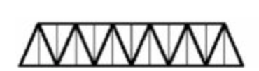
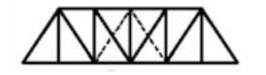
Preliminary Design and Design Considerations
Design Considerations
Simple constructability
Withstanding all load combinations
Considered Bridge Types:
Truss Bridge
Beam Bridge
Figure 5: Warren Truss with Vertical Designs [3]
Figure 6: Howe Truss Design [3]
Final Design Chosen Was an Underslung Truss Bridge
Notes:
Hailley

Slide 8
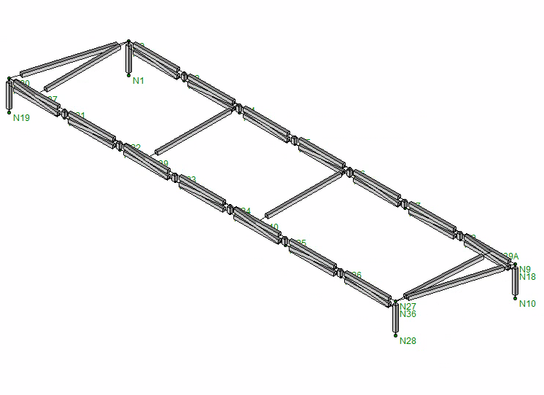
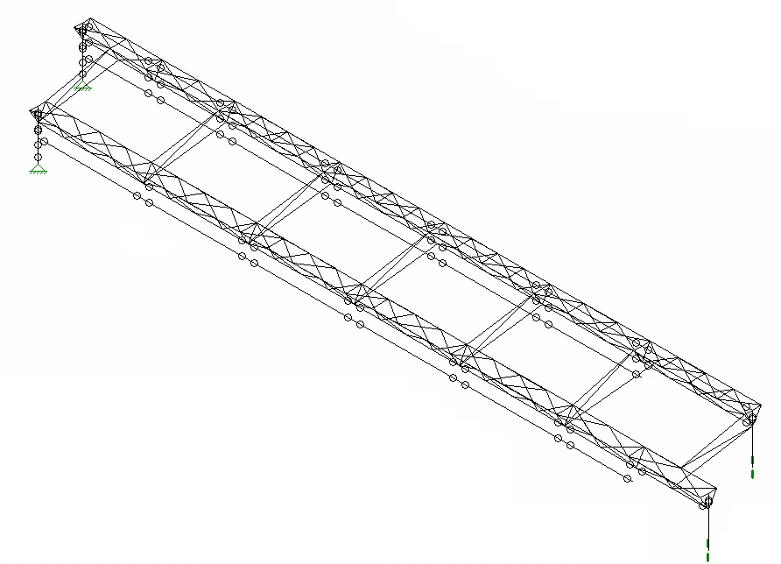
Alternative Bridge Designs Completed by the Team
Figure 7: Steel Bridge Design from September 2019. The team wanted to try the reliability of a truss. Didn’t pass loading test. [4]
Figure 8: Steel Bridge Team Design from October. Design Alternative that would use smaller pieces to be welded together. Weight was too high and complex constructability. [4]
Notes:
Sam

Slide 9
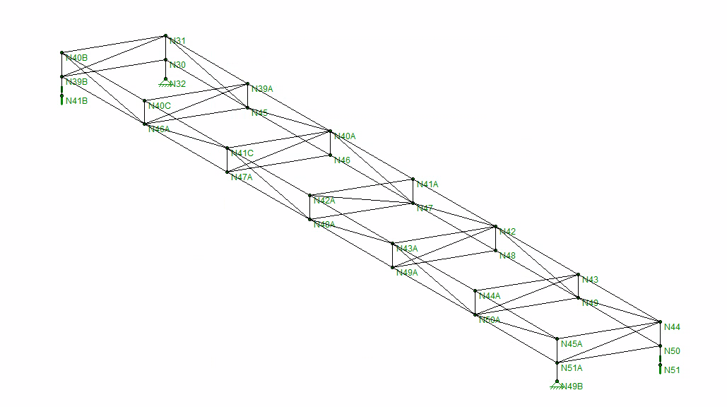
Alternative Bridge Design Completed by the Team cont.
Figure 9: Steel Bridge Design from November of 2019. This design had the addition of more lateral bracing. [4]
Notes:
Steven

Slide 10
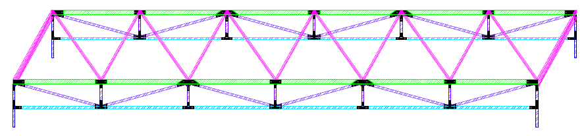
Final Bridge Design as of December 2019
Figure 10: Isometric View of Bridge [2]
How did we figure out this was a good design?
The weight is under 250 lbs
There won’t be many different members so simpler fabrication
Notes:
Steven

Slide 11
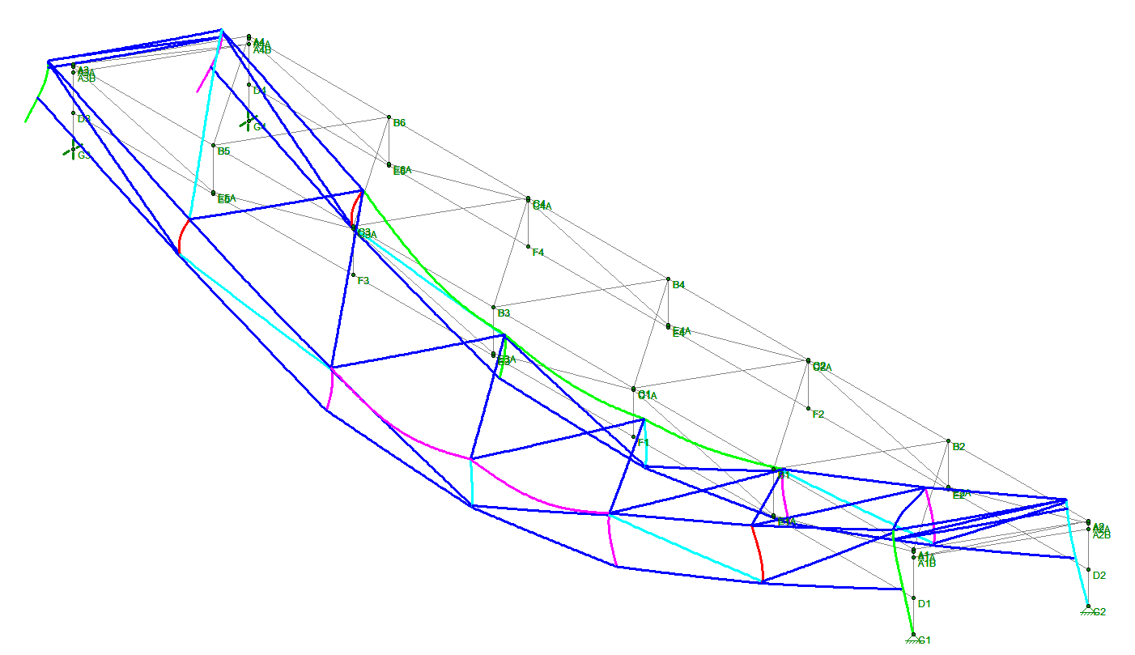
Exaggerated Model of Final Bridge Design
Final bridge weight: 236 lbs
  Includes assumed 25% weight increase from plates and bolts
Max Vertical Deflection: 1.016”
Max Lateral Deflection: 0.086”
Figure 11: Exaggerated Scale on Isometric View of Bridge [4]
Notes:
Steven

Slide 12
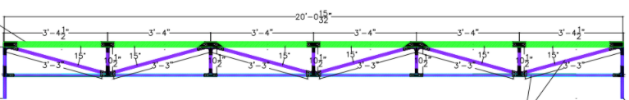
Final Material and Dimensions
Material Type: HSS steel of Grade A513
  Top Chord in Green 2”x 1”x 0.083”
  Bottom Chord in Blue , Webbing and Columns in Purple 1”x 1”x 0.065”
  Bracing not Shown 0.75”x 0.75”x 0.065”
Figure 12: Final Bridge Design with Connections in black [2]
Notes:
Em

Slide 13
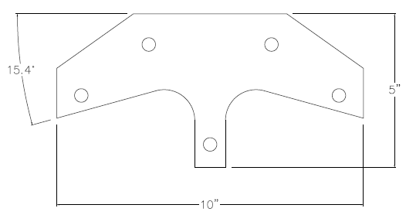
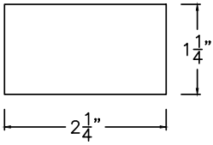
Task 2.3: Connection Design
Type of Connections Chosen
  Gusset Plates
  Steel Tabs
Connection Design
Connection Design Calculations
  AISC Steel Construction Manual
    Tension Capacity
    Bolt Shear Capacity
    Block Shear
    Tensile Rupture Strength
    Bolt Bearing Strength
Figure 13: Connection C [2]
Figure 14: Typical Tab [2]
Notes:
Sam

Slide 14
Connection Design Equations and Importance
Tension Capacity
Strength of the connections with weight placed perpendicular to it
Bolt Shear Capacity
Strength of the shear plane along a bolt in relation to the bolt’s area
Block Shear
Strength of the member to not tear from the plate in a combination of tension and shear
Tensile Rupture
Strength as a measure of reduced area to support the load due to bolt holes
Bolt Bearing Strength
Compressive force of the bolt to the side of the hole
To ensure that the connections were sufficient for the load combinations, the following were tested:
Notes:
sam

Slide 15
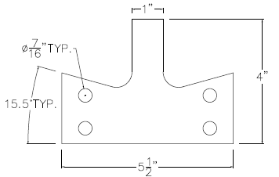
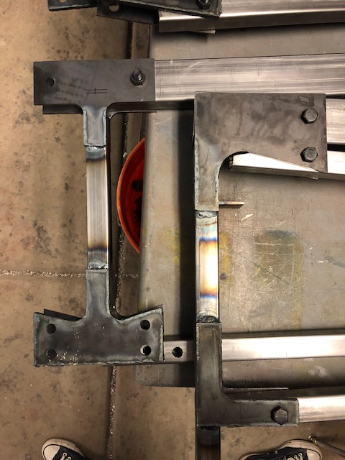
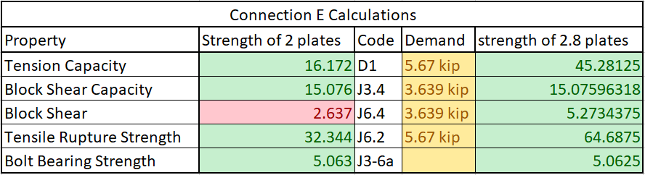
Connection E Calculation Example
Connection Design:
2 plates welded together = 1.8 plates minimum
Figure 16: Connection E [5]
Table 2: Connection E calculations [2]
Figure 15: Connection E [2]
Notes:
sam

Slide 16
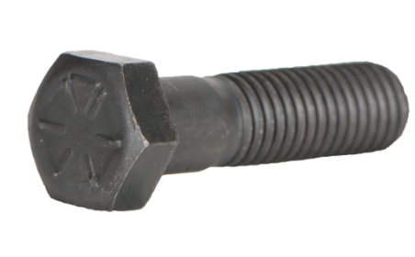
Connection Summary
⅛” thick sheet metal
  2/8” thick plates for 2 plates welded together on exterior
  ⅛” for 1 plate on interior
  Tabs welded perpendicular to interior face
Grade 8 bolts, hex shape head, half threaded
  Used 2 ¼” for members
  Used ½” for Bracing
  Strength is 150 ksi
Figure 17: Example of Hexagon Shaped Grade 8 Bolt with half threaded end [8]
Notes:
Hailley
Choose half thread because we wanted the thread to be on the outside of the two plates. THis was a recommendation of a technical craftsmen.

Slide 17
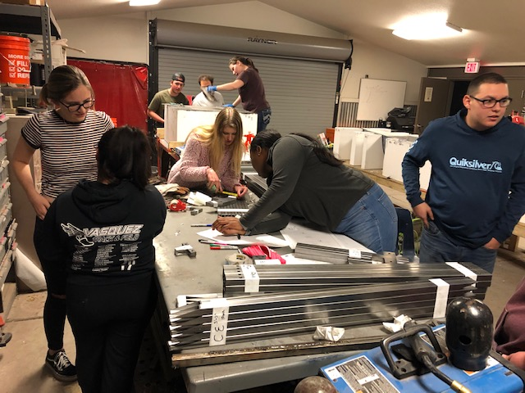
Steel Preparation
Organize and label members
Transport to Mingus High School for Welding Day!
Members Cut Shorter
Member: CF
  20” to 10-½”
Member: AE
  3’-3” to 3’-1¾ ”
Figure 18: Steel Bridge Team and mentees preparing steel after receiving it from K-Zell Metals [5]
Notes:
Em

Slide 18
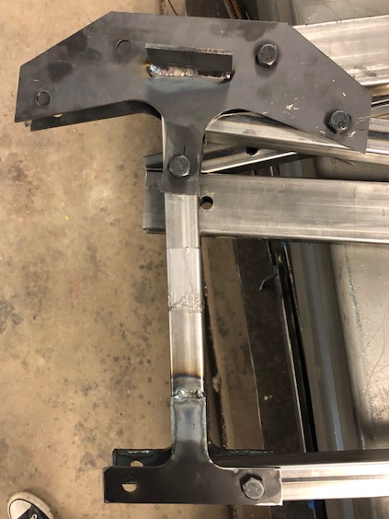
Fabrication
Welding at Mingus High
Connection C and F to member CF with a tab
Connection B and E to member BE
Connection D and A to member AA
Figure 19: From Left to Right - Member CF, BE, AA [5]
Notes:
Hailley

Slide 19
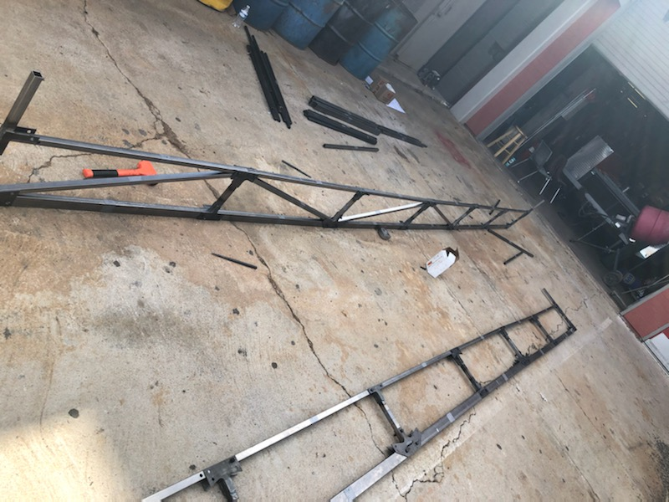
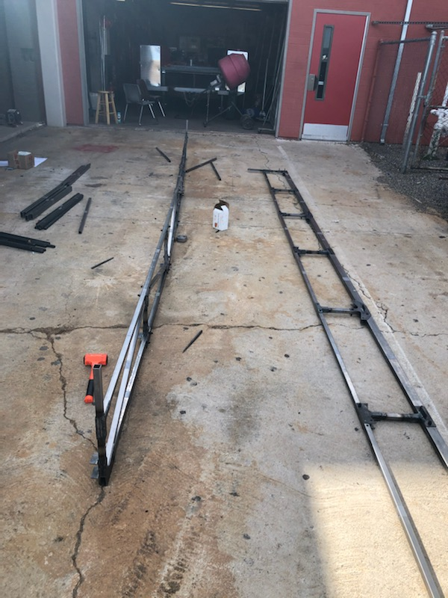
Final Product up to Fabrication
Figure 20 and 21: Picture from Mingus Day during a construction attempt [6]
Notes:
Hailley

Slide 20
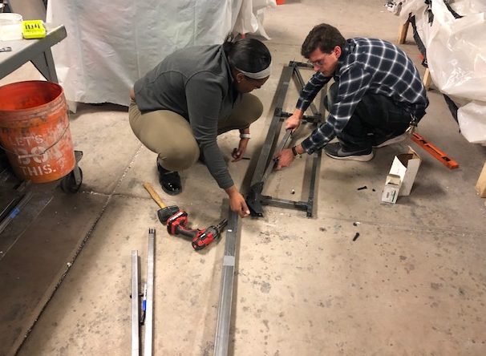
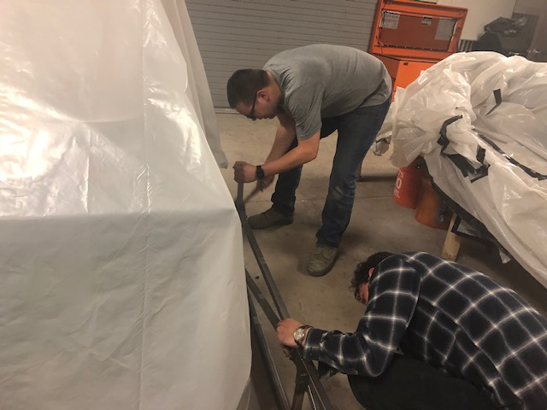
Construction
Construct pieces together to ensure everything fits as planned
Cut and bolt webbing pieces into place
Assess length and height per envelope requirements with tape measure
Figure 22 and 23: Team Members Steven and Hailley working with Mentee Dan during construction attempt to fit webbing members [5]
Notes:
Hailley

Slide 21
Impacts
Environmental
  Reusing and Recycling the Steel, extra bolts, and extra nuts
Social
  Learning to communicate with Professional Engineers and Craftsmen
  Learned to be self-starters
Economic
  We used a lot of materials and gas
  We reused materials and tools at the farm
Notes:
Phteven

Slide 22

Thank You!
We will not Avenge NAU!
[7]
Notes:
Sam

Slide 23
References
[1] AISC website, AISC Steel Bridge Competition. 2019
[2]Steel Bridge Team, Steel Bridge Team Shop Drawings, 2020
[3] North Carolina Department of Transportation, “Truss Bridges” , 7-Jun-2019. [Online] Available: https://www.ncdot.gov/initiatives-policies/Transportation/bridges/historic-bridges/bridge-types/Pages/truss.aspx [Accessed 8-Feb-2020]
[4] RISA, Steel Bridge Team Risa File and Design, 2020
[5] Sam Cole, Pictures of Steel Bridge and People, 2020
[6]Hailley Ndubizu, Pictures of Steel Bridge, 2020
[7]Amazon website, Marvel Legends Series Infinity Gauntlet Articulated Electronic Fist, 2020
[8] Copper State Nuts and Bolts, Grade 8 Bolts, 2020. [Online] Available: https://www.copperstate.com/shop/5637152492/hex-heads-grade-8 [Accessed 23-Apr-2020]

